Slide 1
Airline reservation system
Presented by: Binam Kunwar and Malina Kanaujiya

Slide 2
Introduction
This contains the information related to flight schedule
Admin have the authority to modify the ticket
Holds flight details
Modification in flight detail like add, delete, reschedule
Internal flight
Customer to search availability and price of various airline ticket

Slide 3
Problem statement
Book at ticket counters whereas we can book own
Passenger may not have much freedom whereas this system gives freedom to the user at their own logon
Not user friendly
Less security
Secure cannot be access without permission

Slide 4
Objective
Freedom to user to book ticket
Fight Timing and cancel
Online flight booking
strong password mechanism

Slide 5
Functional requirement
Only authorized person can access related data,
Customer can login through id and password,
Administrator will be responsible for updating the site

Slide 6
Functional requirement
Passanger role :
Should enter information such as:
Name
Passport no
Admistration role:
should be able to add, update and modify flight
View the customer detail

Slide 7
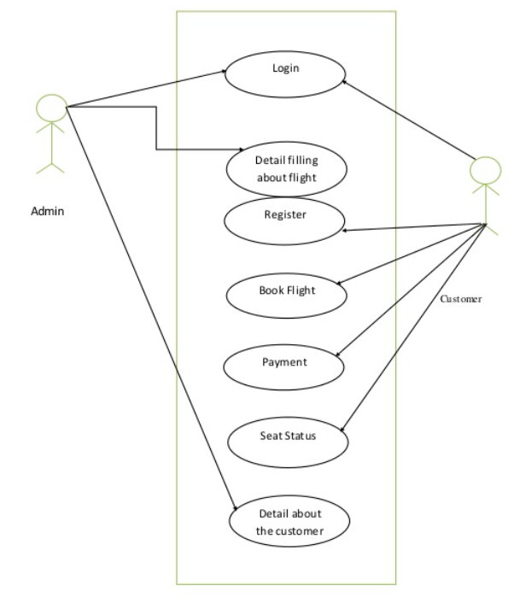
Process

Slide 8
SDLC
Consists of detail plan about develop, maintain, replace
Lifecycle includes:
Planning
Defining
Designing
Building
Testing

Slide 9
Tools and technology
PHP, MYSQL –USED TO DEVELOP WEB APPICATION
Xammp –testing sutie
VS Code –text editor for code
Html –used o design user interface

